Slide 1


Lecture 7: Object Recognition
Harbin Institute of Technology（Shenzhen）
Jingyong Su
sujingyong@hit.edu.cn

Slide 2
Outline
Introduction to Object Recognition
Visual recognition tasks
Challenges
Bias-Variance Trade-off
A Simple Object Recognition Pipeline

Slide 3
What are the different visual recognition tasks?

Slide 4
Classification: Does this image contain a building?

Slide 5
Classification: Is this a beach?

Slide 6
Applications: Searching & Indexing Images
Organizing photo collections

Slide 7
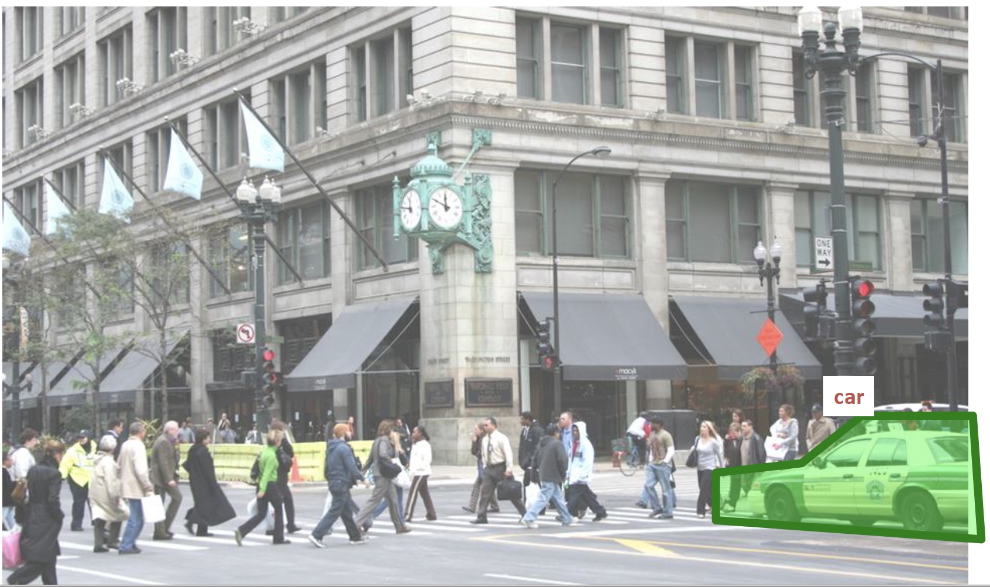
Detection: Does this image contain a car and where?

Slide 8
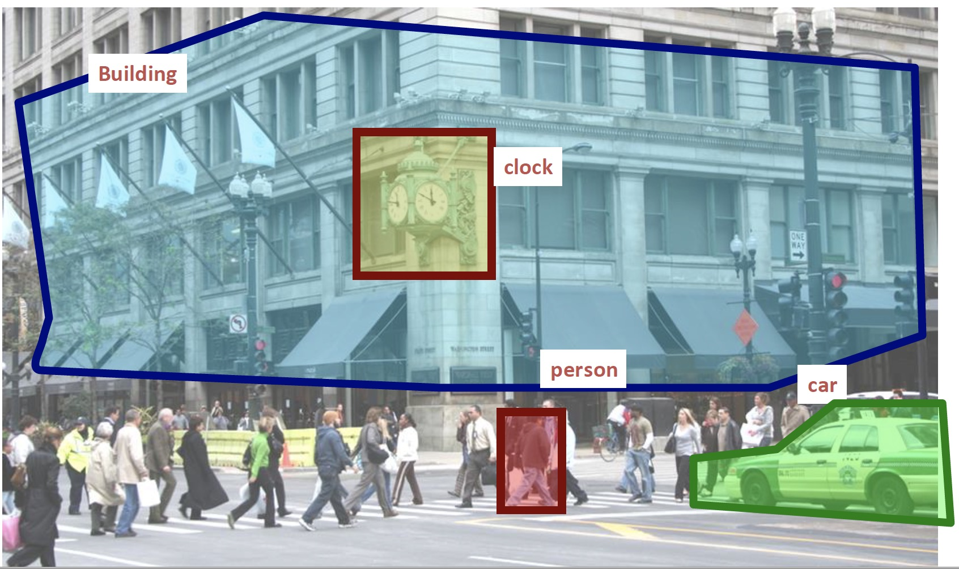
Detection: Which objects does this image contain and where?

Slide 9
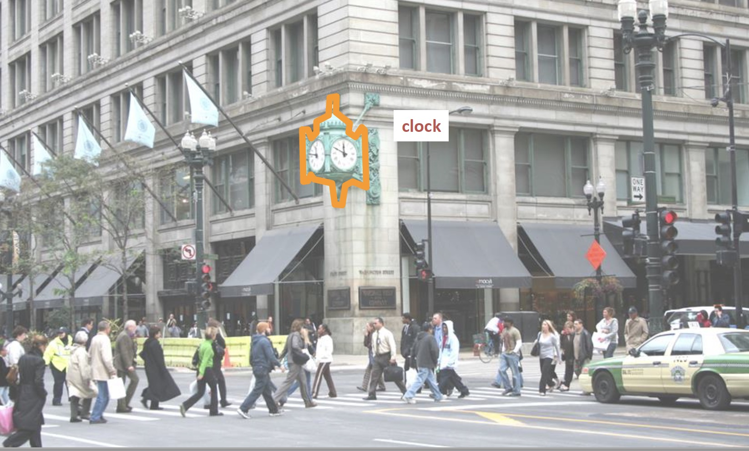
Detection: Accurate localization (segmentation)

Slide 10
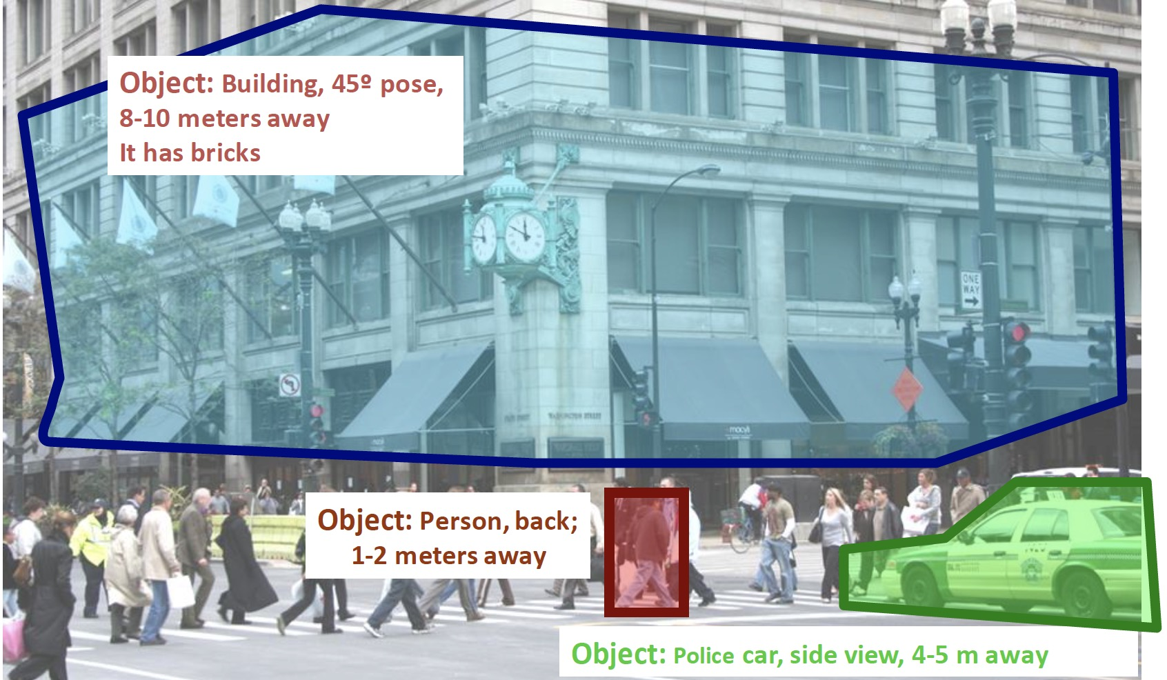
Detection: Estimating object semantic & geometric attributes

Slide 11
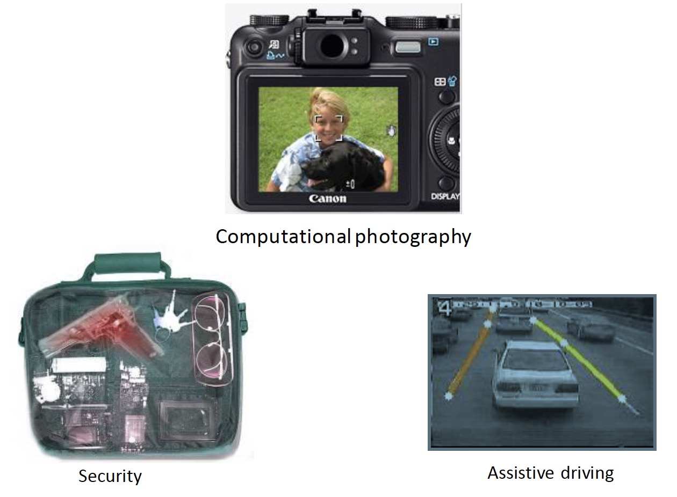
Applications

Slide 12
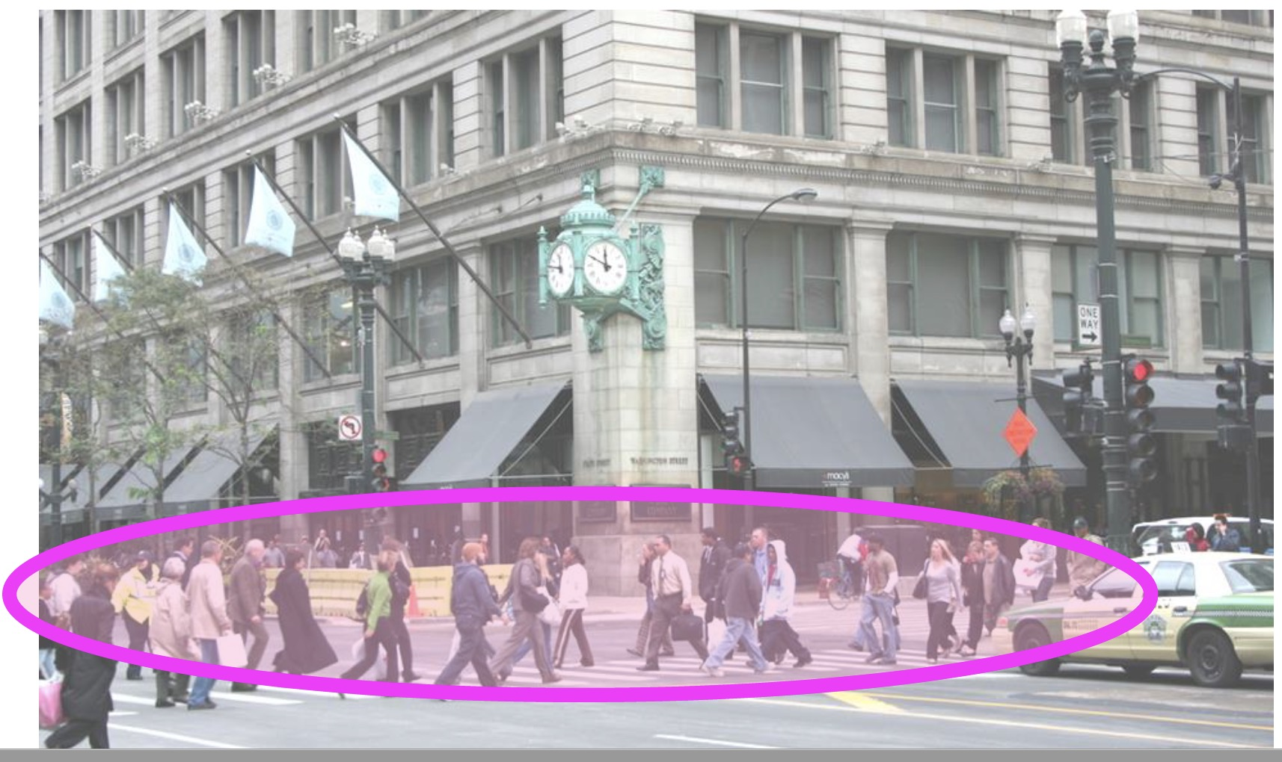
Activity or Event recognition: What are these people doing?

Slide 13
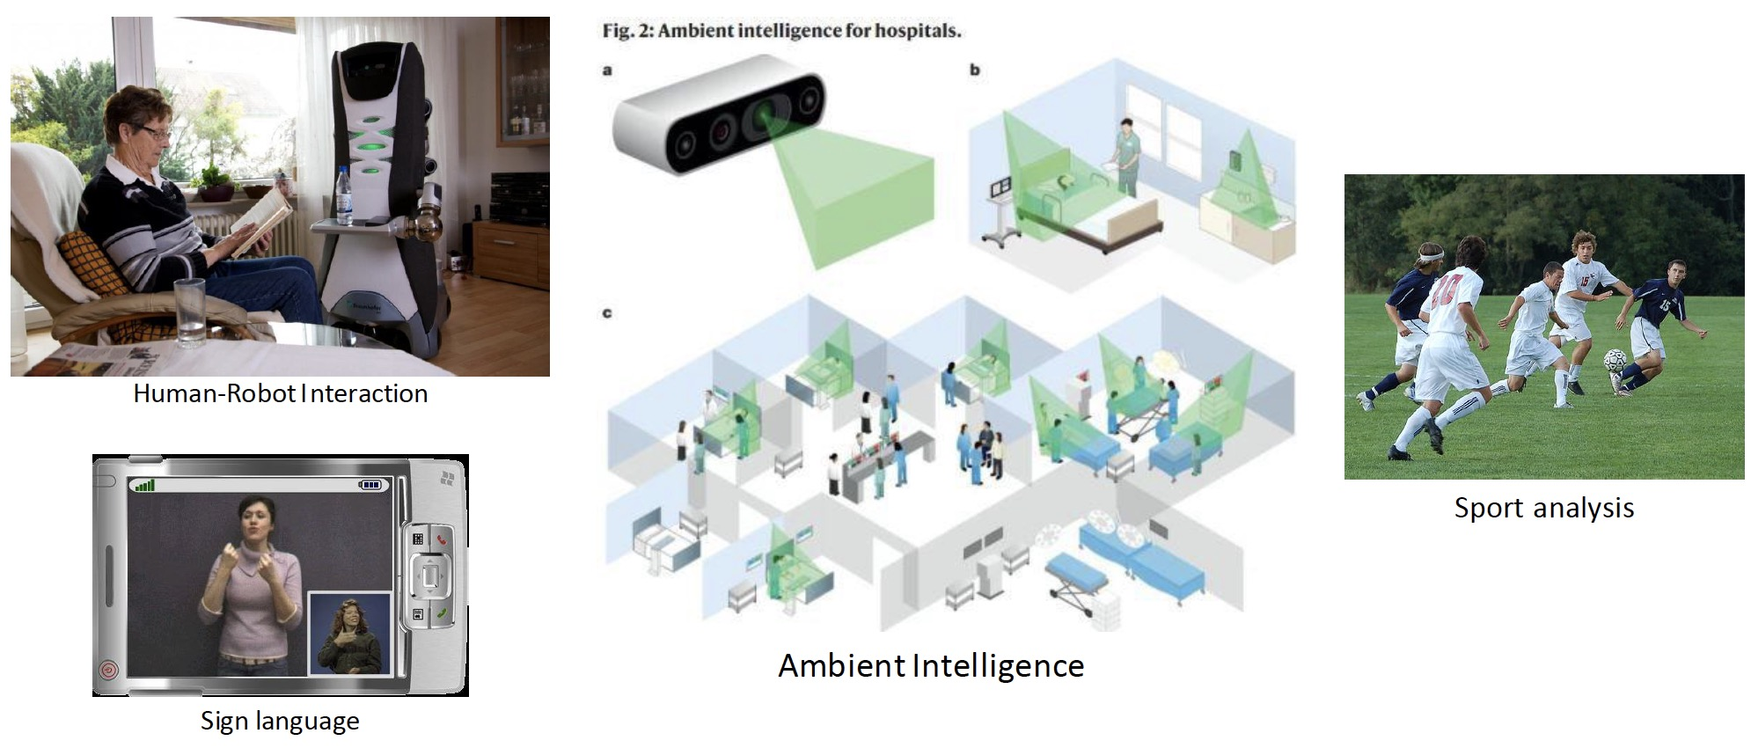
Applications

Slide 14
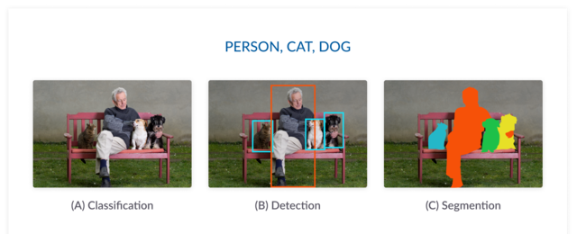
Classification vs Detection vs Segmentation

Slide 15
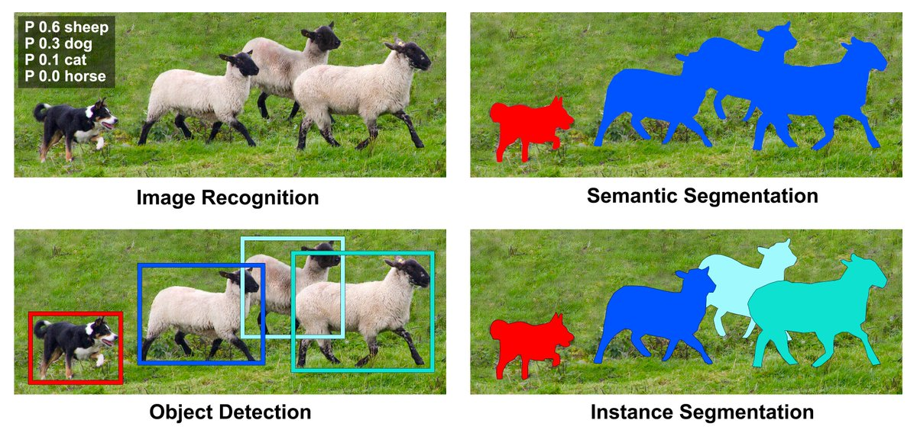
Semantic vs Instance Segmentation

Slide 16
Outline
Introduction to Object Recognition
Visual recognition Tasks
Challenges
Bias-Variance Trade-off
A Simple Object Recognition Pipeline

Slide 17
Visual Recognition
•Design algorithms that have the capability to:
–Classify images or videos
–Detect and localize objects
–Estimate semantic and geometrical attributes
–Classify human activities and events
Why is this challenging?

Slide 18
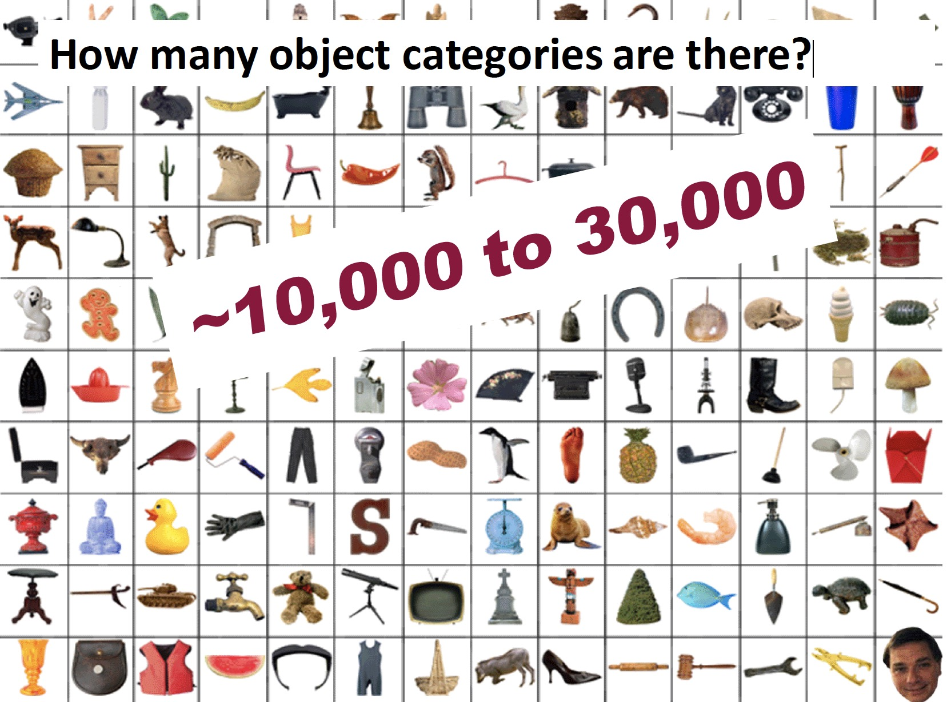

Slide 19
Challenges: Viewpoint variation
Michelangelo 1475-1564

Slide 20
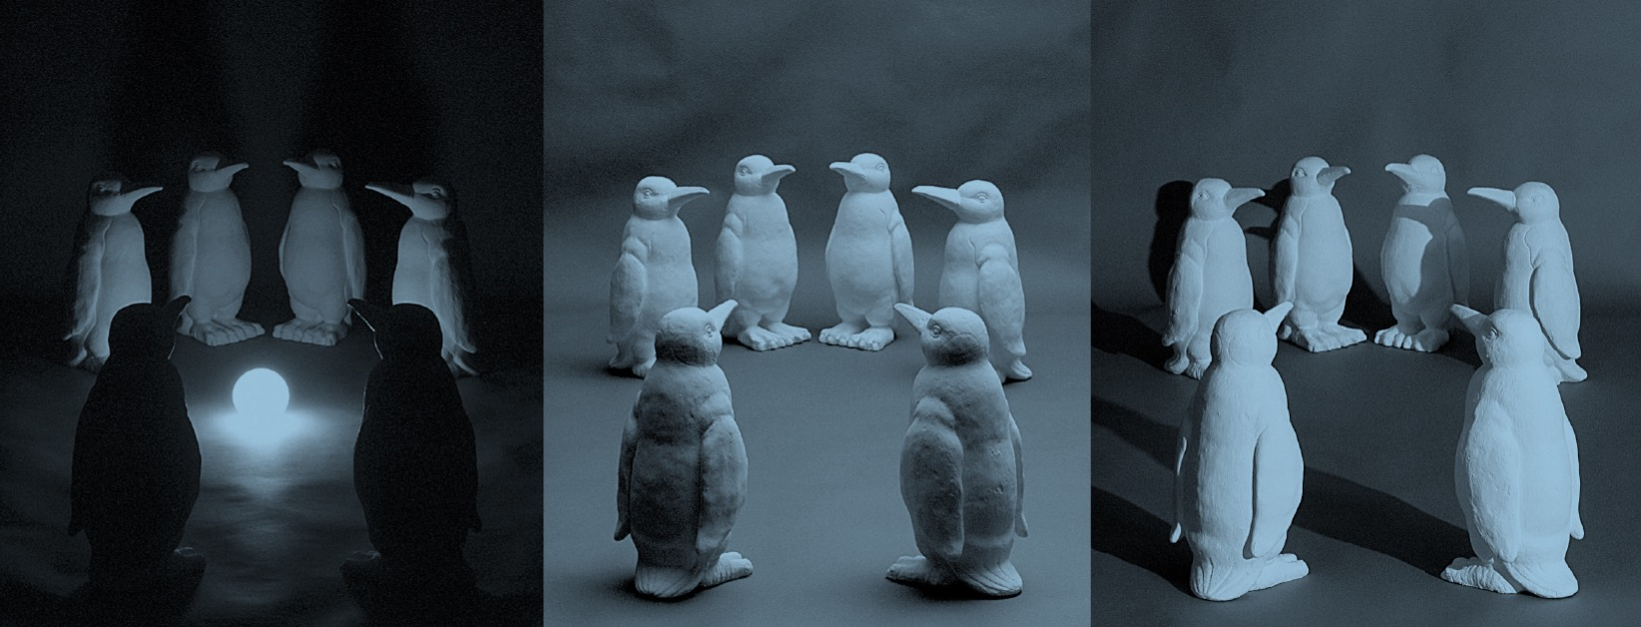
Challenges: Illumination

Slide 21

Challenges: Scale

Slide 22
Challenges: Deformation

Slide 23
Challenges: Occlusion
Magritte, 1957

Slide 24
Challenges: Background clutter

Slide 25
Challenges: Intra-class variation

Slide 26
Outline
Introduction to Object Recognition
Visual recognition tasks
Challenges
Bias-Variance Trade-off
A Simple Object Recognition Pipeline

Slide 27
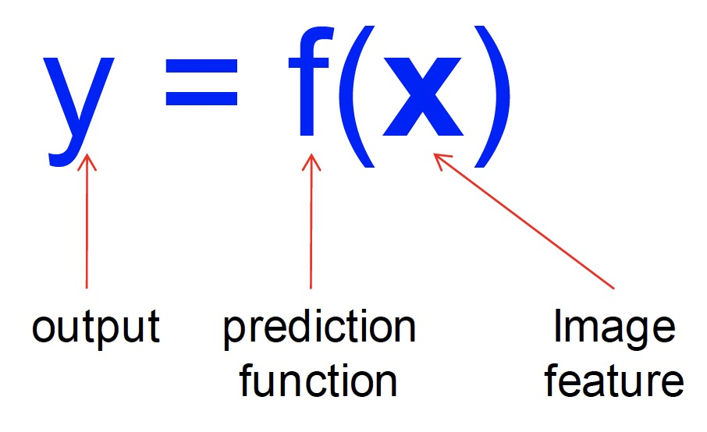
The machine learning framework
•Training: given a training set of labeled examples {(x₁,y₁), …, (x_{N},y_{N})}, estimate the prediction function f by minimizing the prediction error on the training set
•Testing: apply f to a never before seen test example x and output the predicted value y = f(x)

Slide 28
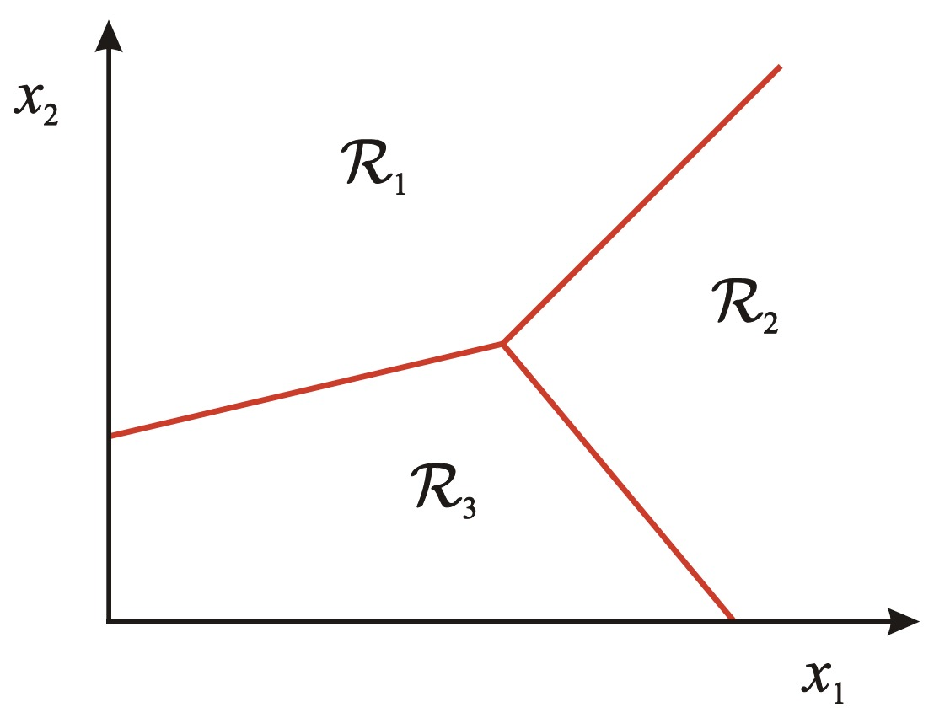
Classification
•Assign input vector to one of two or more classes
•Any decision rule divides input space into decision regions separated by decision boundaries

Slide 29
Many classifiers to choose from
•K-Nearest Neighbor
•SVM
•Neural Networks
•Naïve Bayes
•Bayesian Network
•Logistic Regression
•Randomized Forests
•Boosted Decision Trees
•RBMs
•Etc.
Which is the best one?

Slide 30
Generalization
Training set (labels known) Test set (labels unknown)
•How well does a learned model generalize from the data it was trained on to a new test set?

Slide 31
Bias and Variance
•Models with too few parameters are inaccurate because of a large bias (not enough flexibility).
•Models with too many parameters are inaccurate because of a large variance (too much sensitivity to the sample).

Slide 32
Bias vs Variance
Components of generalization error
–Bias: how much the average model over all training sets differ from the true model?
•Error due to inaccurate assumptions/simplifications made by the model
–Variance: how much models estimated from different training sets differ from each other

Slide 33
Bias vs Variance
•Underfitting: model is too “simple” to represent all the relevant class characteristics
–High bias and low variance
–High training error and high test error
•Overfitting: model is too “complex” and fits irrelevant characteristics (noise) in the data
–Low bias and high variance
–Low training error and high test error

Slide 34
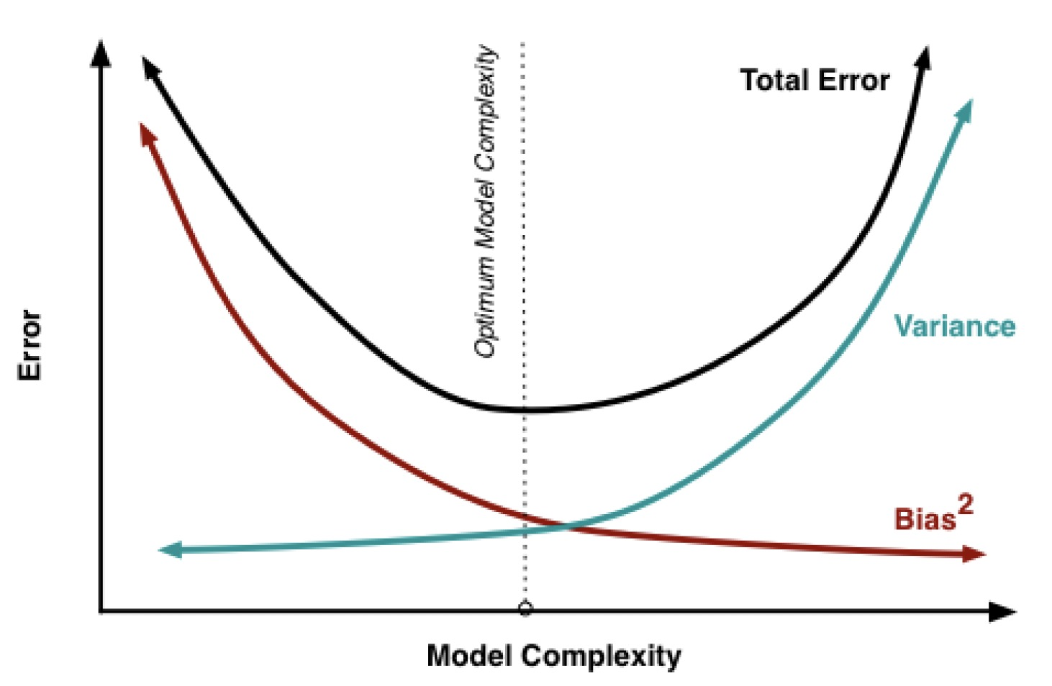
Bias vs Variance Tradeoff

Slide 35
Remember…
•No classifier is inherently better than any other: you need to make assumptions to generalize
•Three kinds of error
–Inherent: unavoidable
–Bias: due to over-simplifications
–Variance: due to inability to perfectly estimate parameters from limited data

Slide 36
How to reduce variance?
• Choose a simpler classifier
• Regularize the parameters
• Get more training data

Slide 37
Last remarks about applying machine learning methods to object recognition
•There are machine learning algorithms to choose from
•Know your data:
–How much supervision do you have?
–How many training examples can you afford?
–How noisy?
•Know your goal (i.e. task):
–Affects your choices of representation
–Affects your choices of learning algorithms
–Affects your choices of evaluation metrics
•Understand the math behind each machine learning algorithm under consideration!

Slide 38
Outline
Introduction to Object Recognition
Visual recognition tasks
Challenges
Bias-Variance Trade-off
A Simple Object Recognition Pipeline

Slide 39
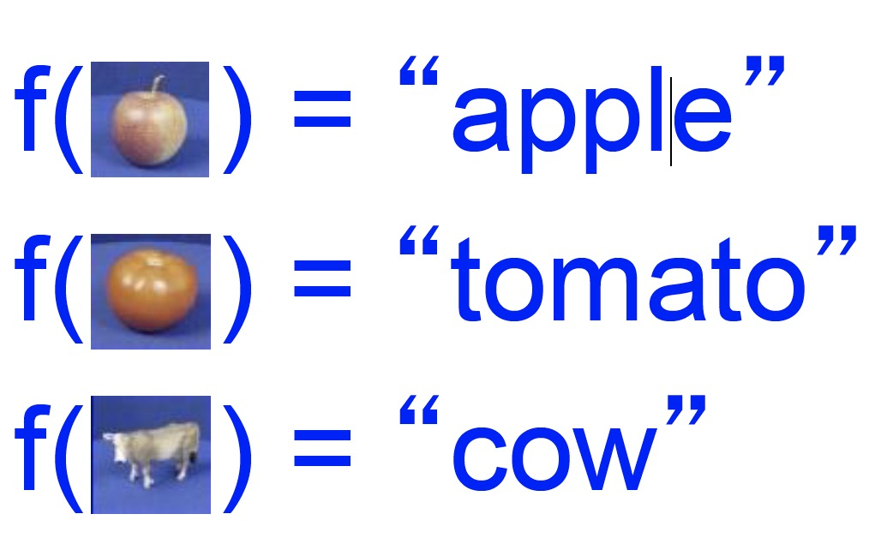
Object recognition: an image classification framework
• Apply a prediction function to a feature representation of the image to get the desired output:

Slide 40
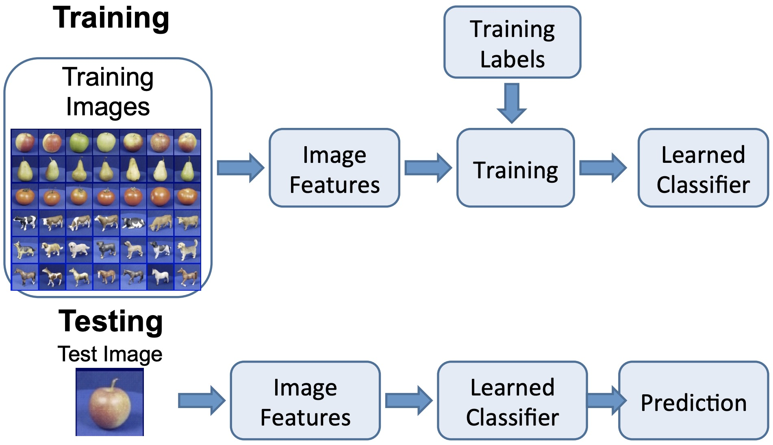
A simple pipeline

Slide 41
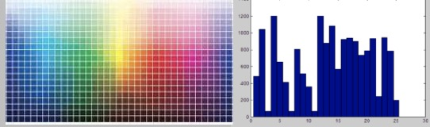

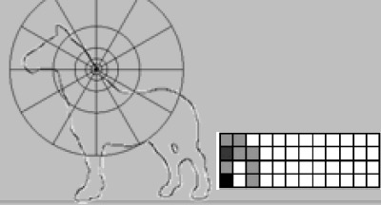
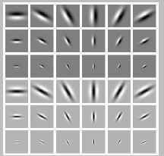
Image features
• Color
• Global shape: PCA space
• Local shape: shape context
• Texture: filter banks

